Slide 1
A Toolkit for Construction of
Genomic and Genetic Websites
Lacey-Anne Sanderson

Slide 2
What is Tripal?
Definition - Features - Customization - Resources
A tool to create community-focused organism websites
Support a variety of non-biological functionality such as forums, conference management, etc.
Display data for analysis and sharing purposes
Incorporating spreadsheet data without conversion and as little administration as possible
Notes:
Lower IT Costs
Upload data into chado completely through the web-interface

Slide 3
What is Tripal trying to Accomplish?
Definition - Features - Customization - Resources
Simplify Construction & Maintenance of Biological Databases
Greater Flexibility of the Biological Website
Expandability
Reusability
Notes:
Reduce development time, costs and IT resources
A non-technical site administrator can add content without knowing PHP, HTML, JavaScript.

Slide 4
What is Tripal?
Definition - Features - Customization - Resources
Drupal
Drupal provides content management
for easy updates by non-technical users and
basic site functionality.
Tripal
Tripal provides data loaders, pages for
visualization, and an API for customization
Chado
Chado stores the biological data

Slide 5
Drupal
Definition - Features - Customization - Resources
Extremely flexible
25,000+ free Modules
add forums, event organization, contact forms, etc.
1,900+ free Themes
change the “look” of your site with a click
Secure
Can be used to build e-commerce sites
Out-of-the-box Professional Websites
Users, permissions, searching, menus, file upload, etc.

Slide 6
Chado
Definition - Features - Customization - Resources
Preferred to be within the Drupal database in a separate schema
Can still be used with GMOD Tools
Data Warehouse
Genome Visualization
Analysis
Pipelines
Structural Annotation
Federated Database
Manual Curation

Slide 7
Chado
Definition - Features - Customization - Resources
Houses a variety of genomic, genetic and other biological data
All of chado is integrated through Drupal/Tripal Views
Assays
Genomic Features
Phylogeny
Organisms
Genotypes
Publications
Analyses
Stocks
Genetic Maps
Ontologies
Phenotypes
Expression
Data

Slide 8
Requirements
Definition - Features - Customization - Resources
UNIX / Linux
Works well on Ubuntu 12.04
Apache web server
PostgreSQL database
PHP5 (for web and command-line)
Drupal 6.x (7.x version projected for Feb 2014)
Server with sufficient memory / processor to handle data load.

Slide 9
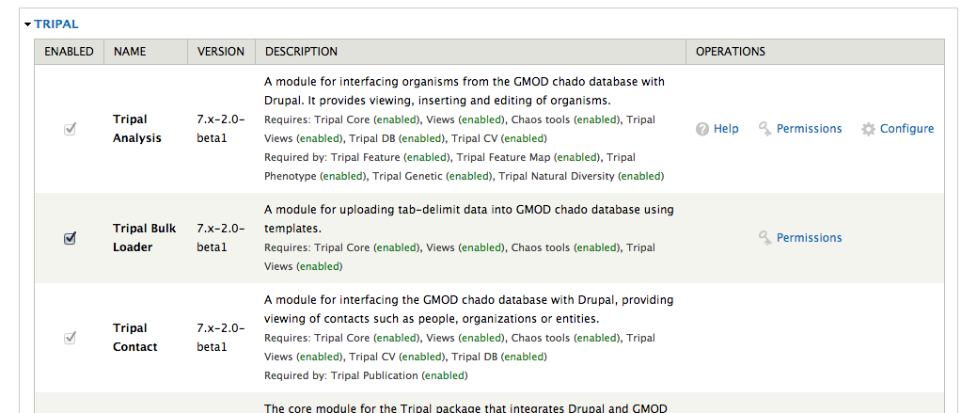
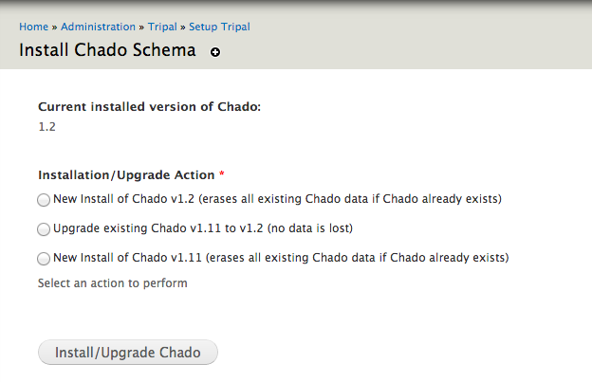
Easy Installation
Definition - Features - Customization - Resources
Detailed online tutorial:
http://gmod.org/wiki/Tripal_Tutorial_(v1.0)
Drupal and Tripal install themselves after some initial setup
Chado can be installed through a single-click

Slide 10
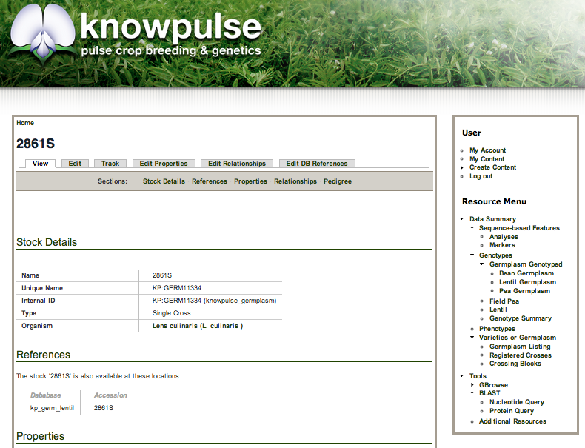
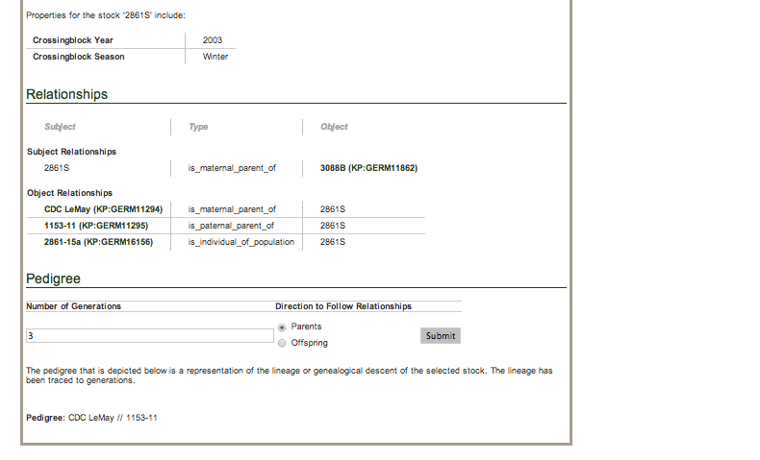
Individual Pages
Definition - Features - Customization - Resources
Tripal creates pages for Organisms, Features, Stocks, etc.

Slide 11
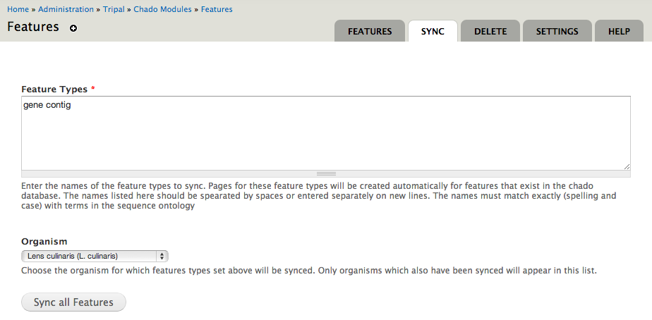
Individual Pages
Definition - Features - Customization - Resources
Tripal creates pages for Organisms, Features, Stocks, etc.
Indicate which Types or Organisms Pages should be created for in Sync Settings

Slide 12
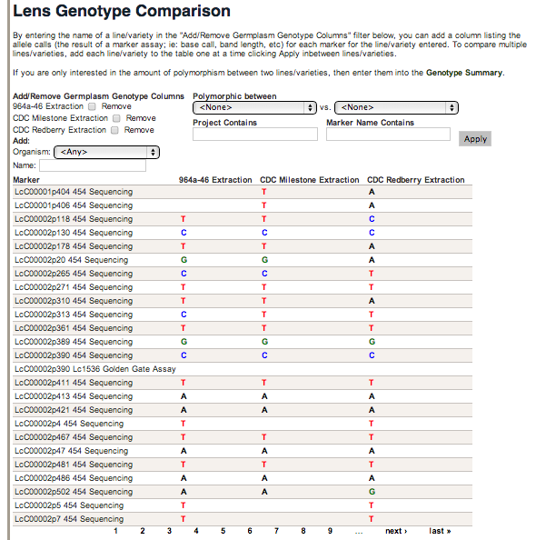
Data Listings
Definition - Features - Customization - Resources
Integration with Drupal Views allows for creating custom listings through the web interface
Expose filters to the user

Slide 13
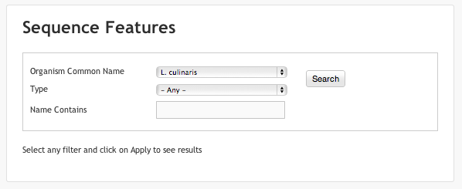
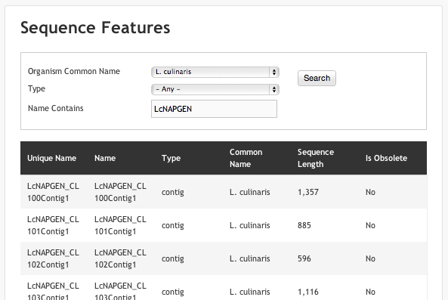
Searching
Definition - Features - Customization - Resources
Can be customized through the web interface
Results listed as either a table or grid
Advanced search capabilities as well as simple keyword searching

Slide 14
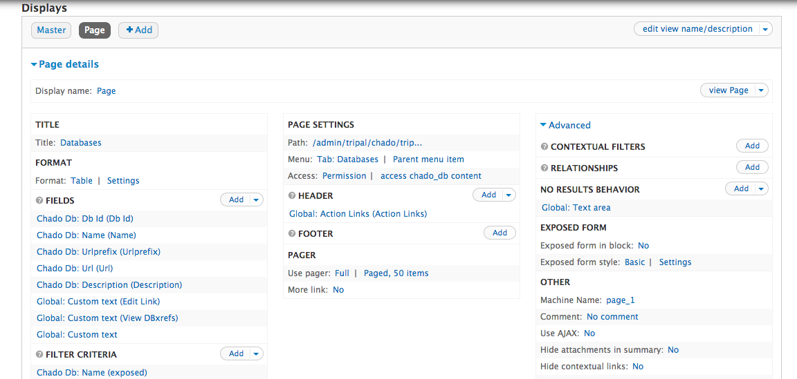
Drupal/Tripal Views
Definition - Features - Customization - Resources
Drupal Views: User Interface to create Database Queries without knowledge of SQL
Flexibility to create Tables, Grids, Lists, etc.
Handles Joins and Aggregation (Views 3)

Slide 15
Drupal/Tripal Views
Definition - Features - Customization - Resources
Drupal Views: User Interface to create Database Queries without knowledge of SQL
Tripal Views: Integration of all of chado with Drupal Views
Abstracted such that nothing is hardcoded and definitions can be edited through the UI
Is extended to custom chado tables and materialized views

Slide 16
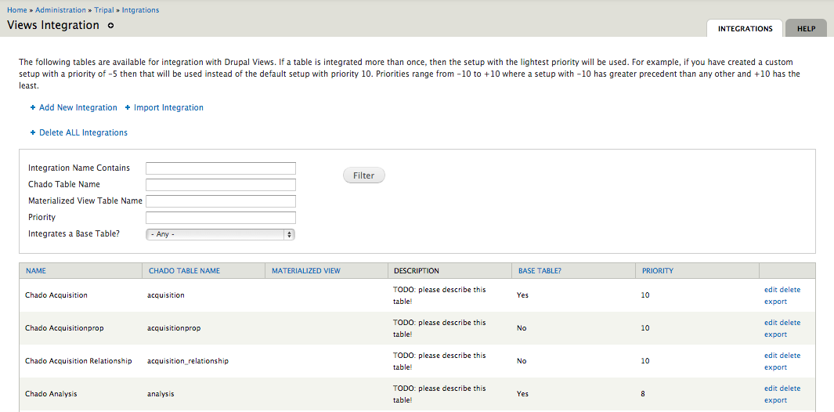
Drupal/Tripal Views
Definition - Features - Customization - Resources
Drupal Views: User Interface to create Database Queries without knowledge of SQL
Tripal Views: Integration of all of chado with Drupal Views
Abstracted such that nothing is hardcoded and definitions can be edited through the UI
Is extended to custom chado tables and materialized views

Slide 17
Loading Data
Definition - Features - Customization - Resources
Loaders provided for common data types
GFF3, FASTA, OBO
Specification of loading job is done through well described forms with advanced options available

Slide 18
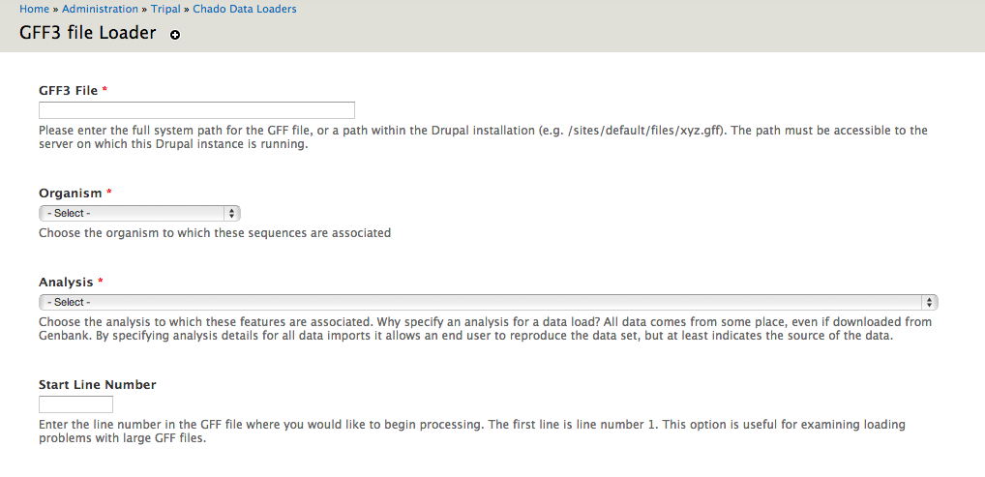
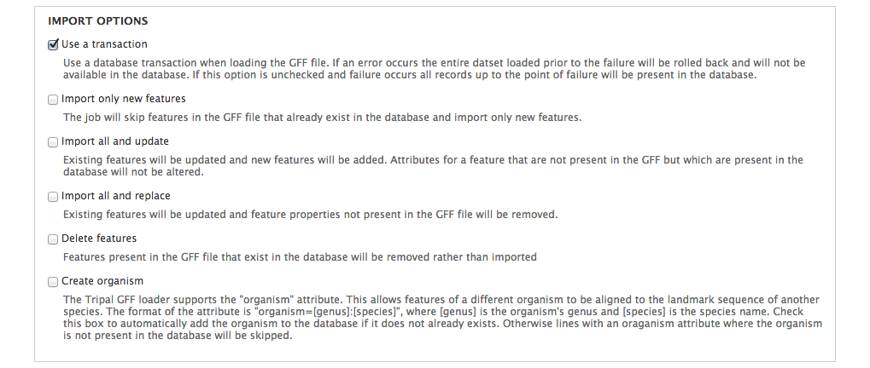
Loading Data
Definition - Features - Customization - Resources
Loaders provided for common data types
GFF3, FASTA, OBO
Specification of loading job is done through well described forms with advanced options available

Slide 19
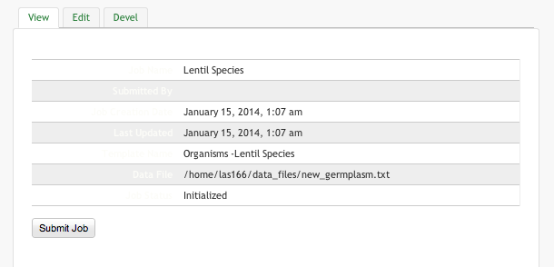
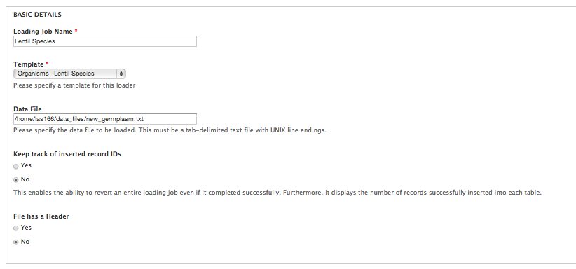
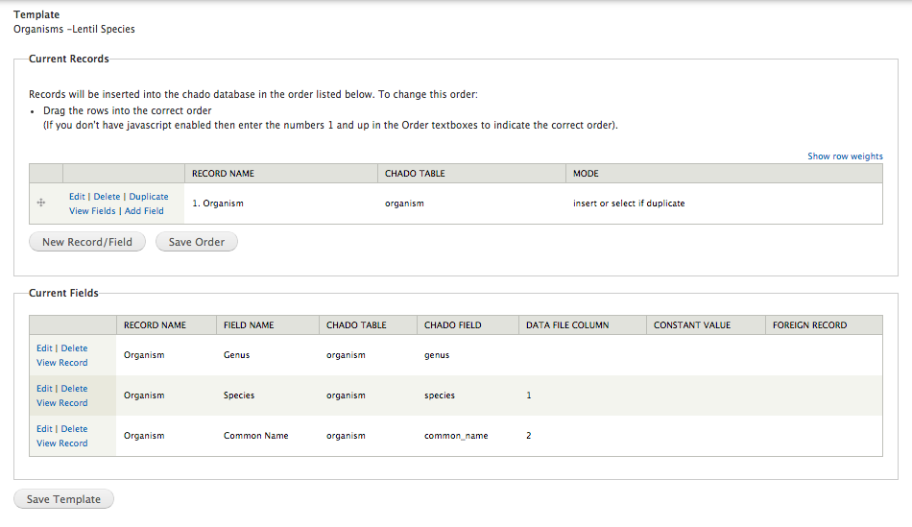
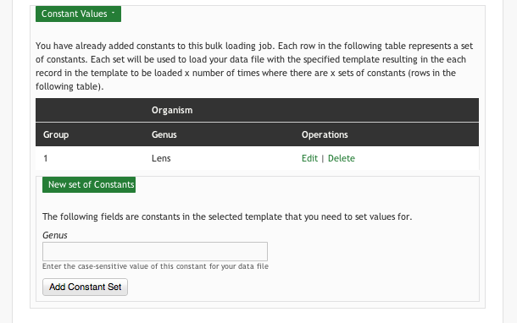
Loading Data
Definition - Features - Customization - Resources
Generic Bulk Loader allows for custom loading of any tab-delimited file into any set of tables in Chado
Create a template specifying a mapping between your file and chado
Then re-use that template with multiple files to load your data

Slide 20
Intuitive Administration
Definition - Features - Customization - Resources
Administrative content listings for each type of data
Many filters to narrow listing to those of interest
Convenient add, edit, delete links
Settings form easy to reach from listing
Help tab for additional information & tips

Slide 21
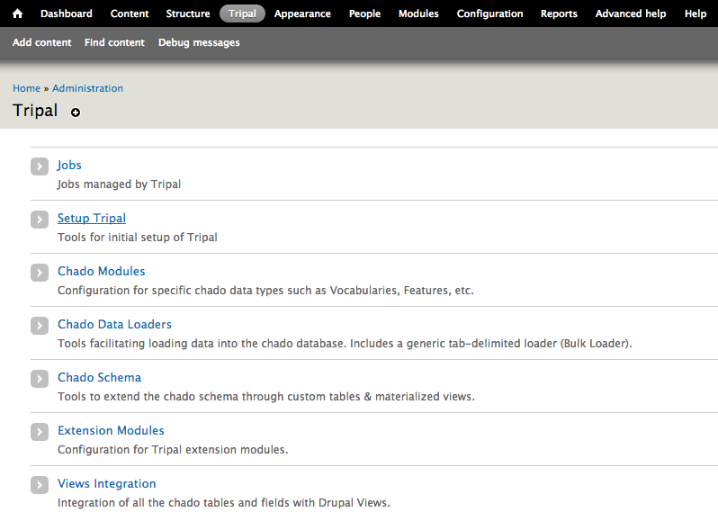
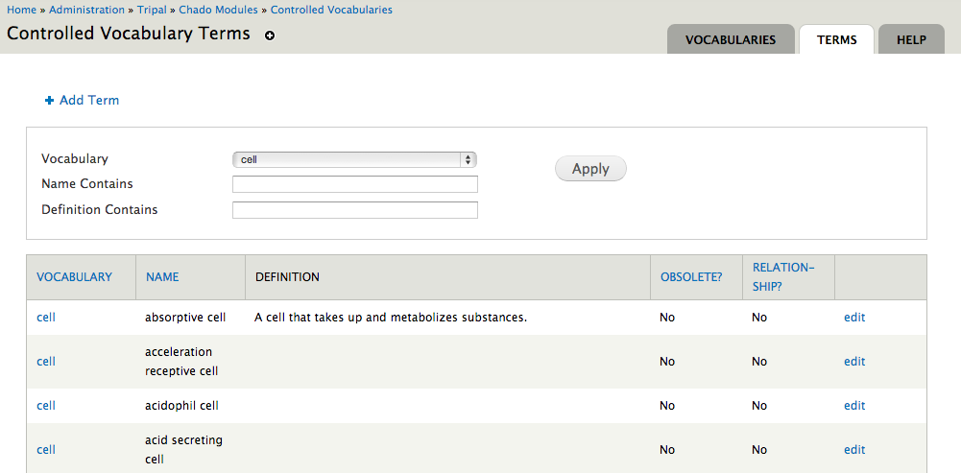
Intuitive Administration
Definition - Features - Customization - Resources
Administrative content listings for each type of data
Many filters to narrow listing to those of interest
Convenient add, edit, delete links
Settings form easy to reach from listing
Help tab for additional information & tips

Slide 22
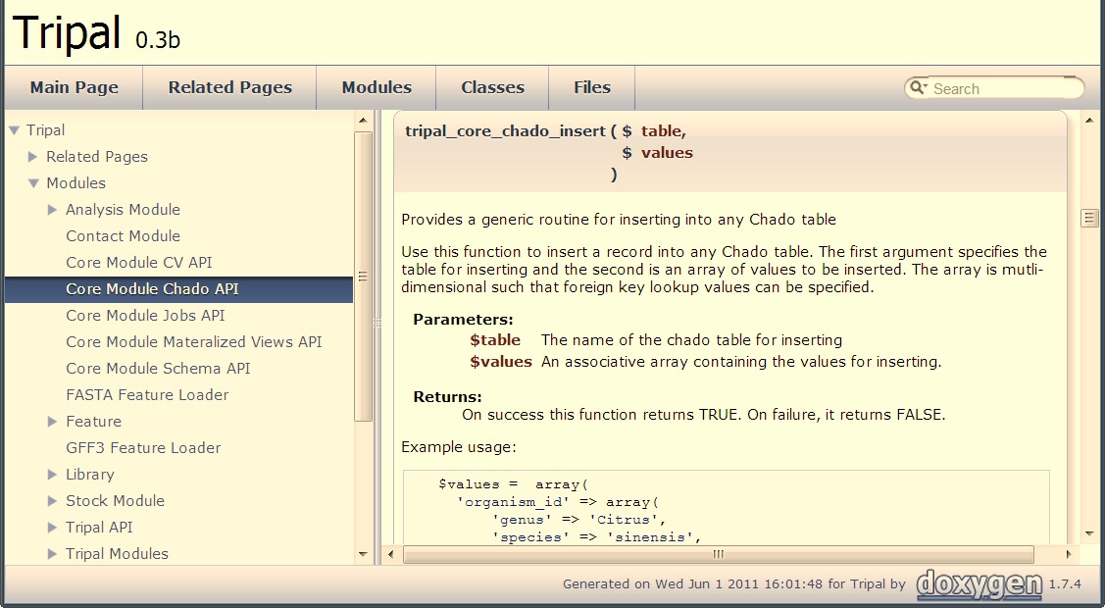
Developers API
Definition - Features - Customization - Resources
Well-documented Application Programmers Interface (API)

Slide 23
Developers API
Definition - Features - Customization - Resources
Facilitates extension of all areas of Tripal
Interactions with Chado
Integration with Drupal/Tripal Views
Custom tables & Materialized Views
Job Management including the Tripal Bulk Loader
And Many More!
Provides for ultimate customization capabilities
Dedicated to Backwards compatibility

Slide 24
Custom Themeing
Definition - Features - Customization - Resources
You can add custom templates to change the layout and content of any content page
Listing colors and layouts can also be changed using template files

Slide 25
Custom Themeing
Definition - Features - Customization - Resources
You can add custom templates to change the layout and content of any content page
Listing colors and layouts can also be changed using template files

Slide 26
Tripal Extensions
Definition - Features - Customization - Resources
Anyone may help with development of Chado-centric modules but in coordination with core Tripal developers
Anyone can develop application and extension modules
We will post extension modules on the Tripal website for others to use.
Tripal Core (API)
Tripal Chado Modules
Extension Modules (e.g. Analyses)
Applications

Slide 27
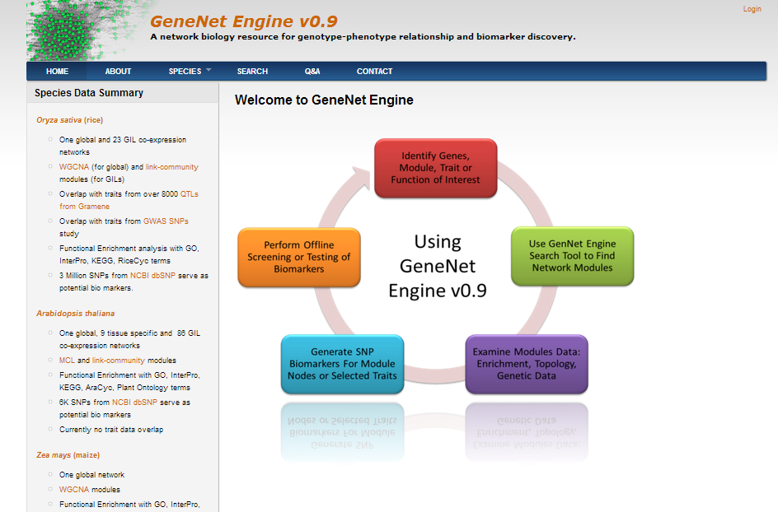
Extendibility Example
Definition - Features - Customization - Resources
Employs
Tripal features, organism, markers, phenotypes
Custom tables for storing networks
Materialized Views
Tripal API for custom module and templates

Slide 28
Future Plans
Definition - Features - Customization - Resources
Drupal 7 compatible version to be released in February 2014 (beta)
Drupal 7 is much faster and has greatly improved Database interactions
Improved Administration both of Drupal & Tripal
Greatly Improved Drupal Views!
You can actually join 8+ tables deep and grouping is supported

Slide 29
Future Plans
Definition - Features - Customization - Resources
Drupal 7 compatible version to be released in February 2014 (beta)
Web-services to facilitate sharing data between Tripal sites and with other applications
JBrowse Integration

Slide 30
Sites using Tripal
Definition - Features - Customization - Resources
KnowPulse
http://knowpulse2.usask.ca/portal
Genome Database for Rosaceae
http://www.rosaceae.org
Fagaceae Genome Web
http://www.fagaceae.org
CottonGen
http://www.cottongen.org
Cacao Genome Database
http://www.cacaogenomedb.org
Hardwood Genome Project
www.hardwoodgenomics.org/
Cool Season Food Legume Database
http://www.gabcsfl.org
Citrus Genome Database
http://www.citrusgenomedb.org/
Genome Database for Vaccinium
http://www.vaccinium.org
Marine Genomics Project
http://www.marinegenomics.org
Banana Genome Hub
http://banana-genome.cirad.fr/
Many more Tripal-based Communities are under Development!

Slide 31
Contributing Organizations
Definition - Features - Customization - Resources
University of Saskatchewan
Lacey-Anne Sanderson
Kirstin Bett, Ph.D
Ontario Institute for Cancer Research
GMOD Coordinator, Scott Cain, Ph.D
John Hopkin’s University
Previous GMOD Help Desk now at Galaxy, Dave Clements
University of California, Berkeley
Current GMOD Help Desk, Amelia Ireland
Main Bioinformatics Lab
Stephen Ficklin (project lead)
Chun-Huai Chen
Taein Lee
Dorrie Main, Ph.D
Il-Hyung Cho, Ph.D.
Sook Jung, Ph.D
Clemson University Genomics Institute
Meg Staton, Ph.D

Slide 32
Funding Sources
Definition - Features - Customization - Resources
Current Funding
Tree Fruit GDR: Translating Genomics into Advances in Horticulture: USDA Specialty Crops Research Initiative, September 2009 – August 2013.
An Integrated Web-based Relational Database for the Curation of Cacao Genetic and Genomic Data: USDA-ARS SCA, January 2009 - January 2013.
Developing an Online Toolbox for Tree Fruit Breeding: Washington Tree Fruit Research Commission, April 2009 – March 2012.
RosBREED: Enabling Marker-assisted Breeding in Rosaceae: USDA Specialty Crops Research Initiative, September 2009 – August 2013
Genomics-Assisted Plant Breeding for Cool Season Food Legumes: University of Idaho Special Grants, USDA NIFA, May 2010 – April 2013
Loblolly Pine Genome Sequencing: USDA DOE, January 2011-January 2016
LenGen: Saskatchewan Pulse Growers Association, September 2013 – September 2015
iMAP: Saskatchewan Pulse Growers Association, September 2010 – September 2013
Comparative Genomics of Environmental Stress Responses in North American Hardwoods: NSF Plant Genome Research Program, February 2011 - January 2015
Past Funding
PURENET: Agriculture and Agri-Food Canada
Genomic Tool Development for the Fagaceae, NSF Award #0605135
Clemson University Genomics Institute (CUGI)
Clemson’s Cyberinfrastructure and Technology Integration Group (CITI)

Slide 33
Tripal Resources
Definition - Features - Customization - Resources
Tripal Website:
http://tripal.info/
Tutorials on GMOD
http://gmod.org/wiki/Tripal_Tutorial_(v1.0)
Mailing Lists
https://lists.sourceforge.net/lists/listinfo/gmod-tripal
Documented API
http://tripal.sourceforge.net/docs/tripal-0.6x-0.3b/index.html
Developer’s Handbook
http://gmod.org/wiki/Tripal_Developer's_Handbook

Slide 34
Tripal Resources
Definition - Features - Customization - Resources
Tripal Website:
http://tripal.info/
Tutorials on GMOD
http://gmod.org/wiki/Tripal_Tutorial_(v1.0)
Mailing Lists
https://lists.sourceforge.net/lists/listinfo/gmod-tripal
Documented API
http://tripal.sourceforge.net/docs/tripal-0.6x-0.3b/index.html
Developer’s Handbook
http://gmod.org/wiki/Tripal_Developer's_Handbook
Thank You!

Slide 35
Tripal Resources
Definition - Features - Customization - Resources
Tripal Website:
http://tripal.info/
Tutorials on GMOD
http://gmod.org/wiki/Tripal_Tutorial_(v1.0)
Mailing Lists
https://lists.sourceforge.net/lists/listinfo/gmod-tripal
Documented API
http://tripal.sourceforge.net/docs/tripal-0.6x-0.3b/index.html
Developer’s Handbook
http://gmod.org/wiki/Tripal_Developer's_Handbook

Slide 36
Definition - Features - Customization - Resources

